Slide 1
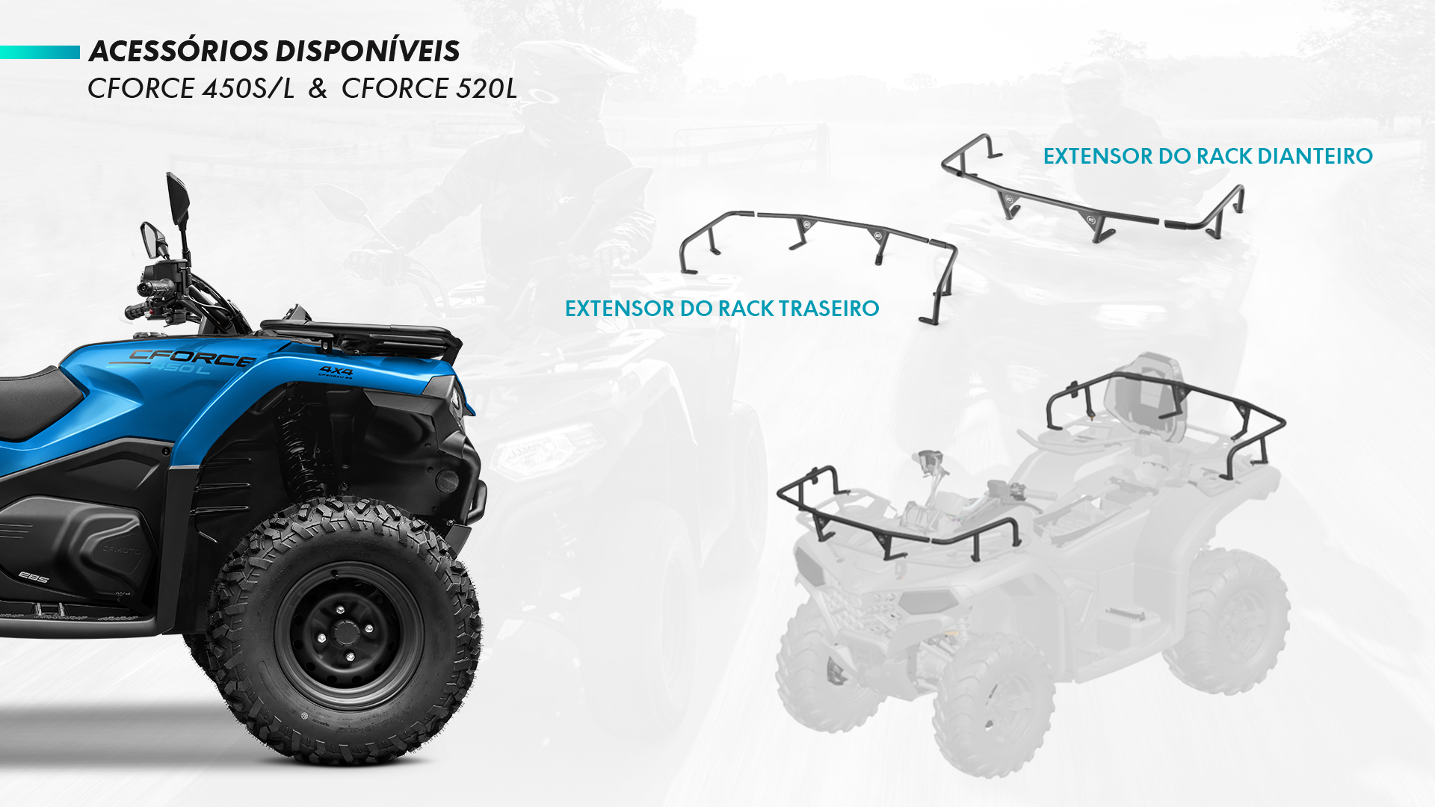
9DRV-802400-3000
9DQV-802300-3000

Slide 2

9DQV-801100-3000
9DQV-801300-3000

Slide 3
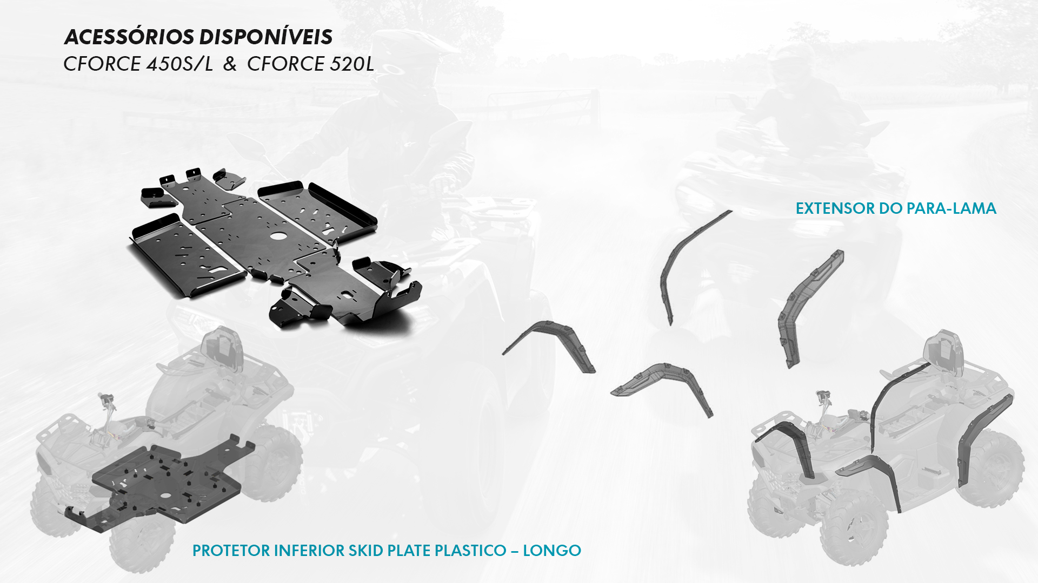
9DQV-803100-3000
9CQV-804200-3000

Slide 4

9DQV-802100-3000

Slide 5

9DQV-806200-3000

Slide 6

9DQV-806100-3001
9DQV-806100-3002

Slide 7

9CQV-806800-3000

Slide 8
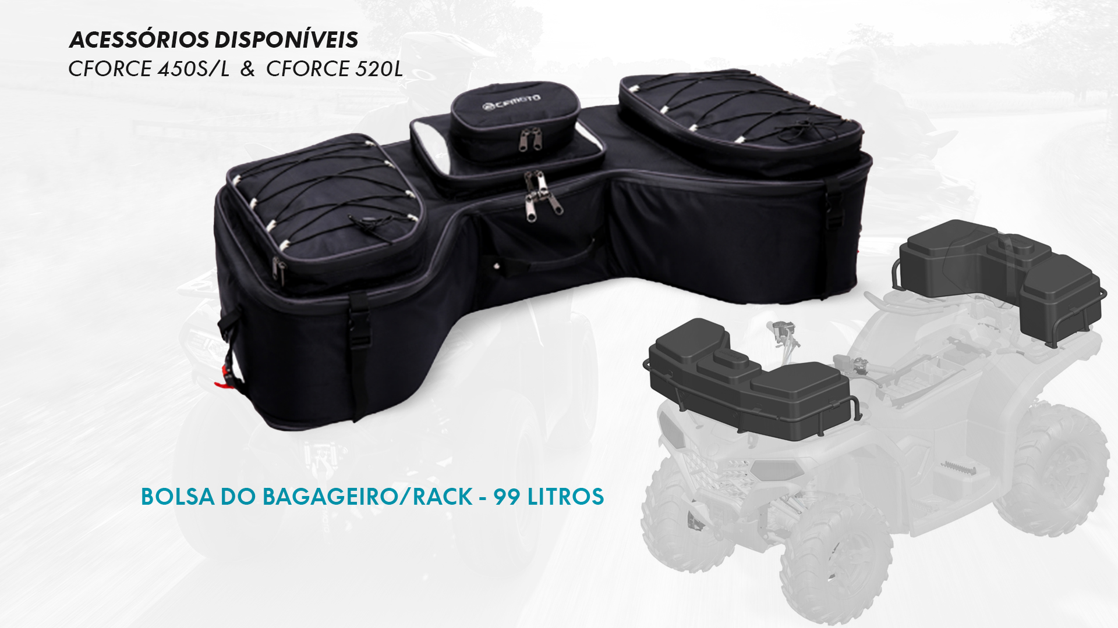
9DS#-809200-6000

Slide 9

9DQV-809100-3000

Slide 10

9DQV-805200-3000

Slide 11

9DQV-808400-3000

Slide 12

Verde: 85224Z-00000
Azul 85224Z-00100

Slide 13
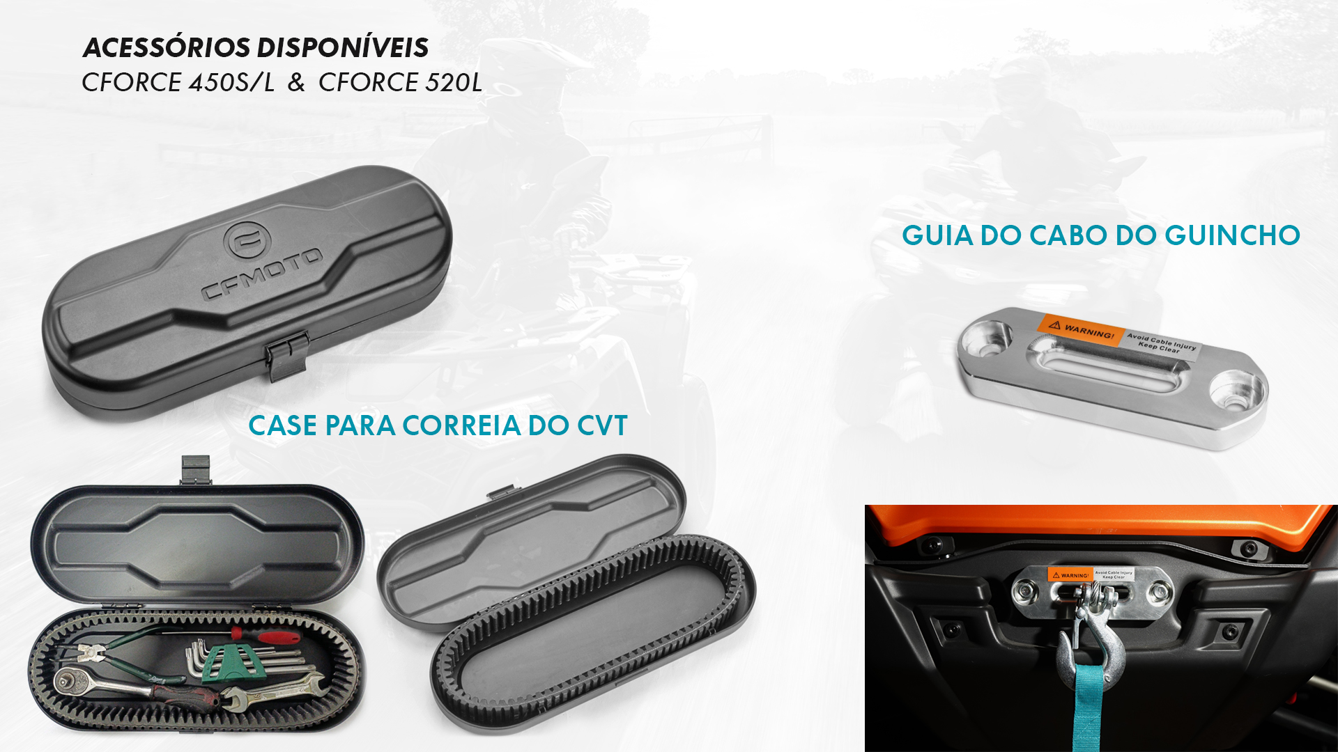
7030-150701
5BYV-804100-1000

Slide 14
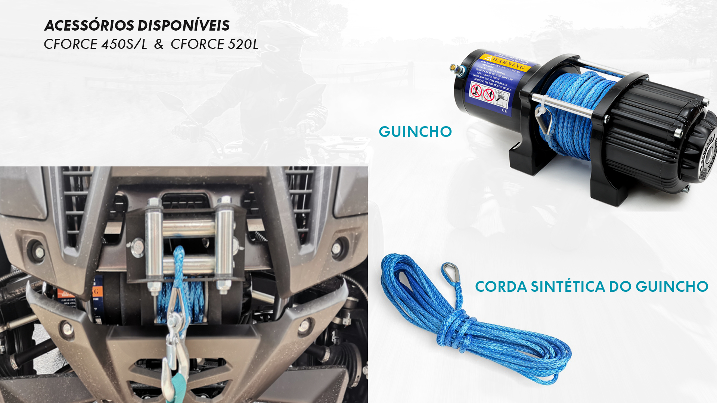
9CQV-807000-3000
7020-800750

Slide 15
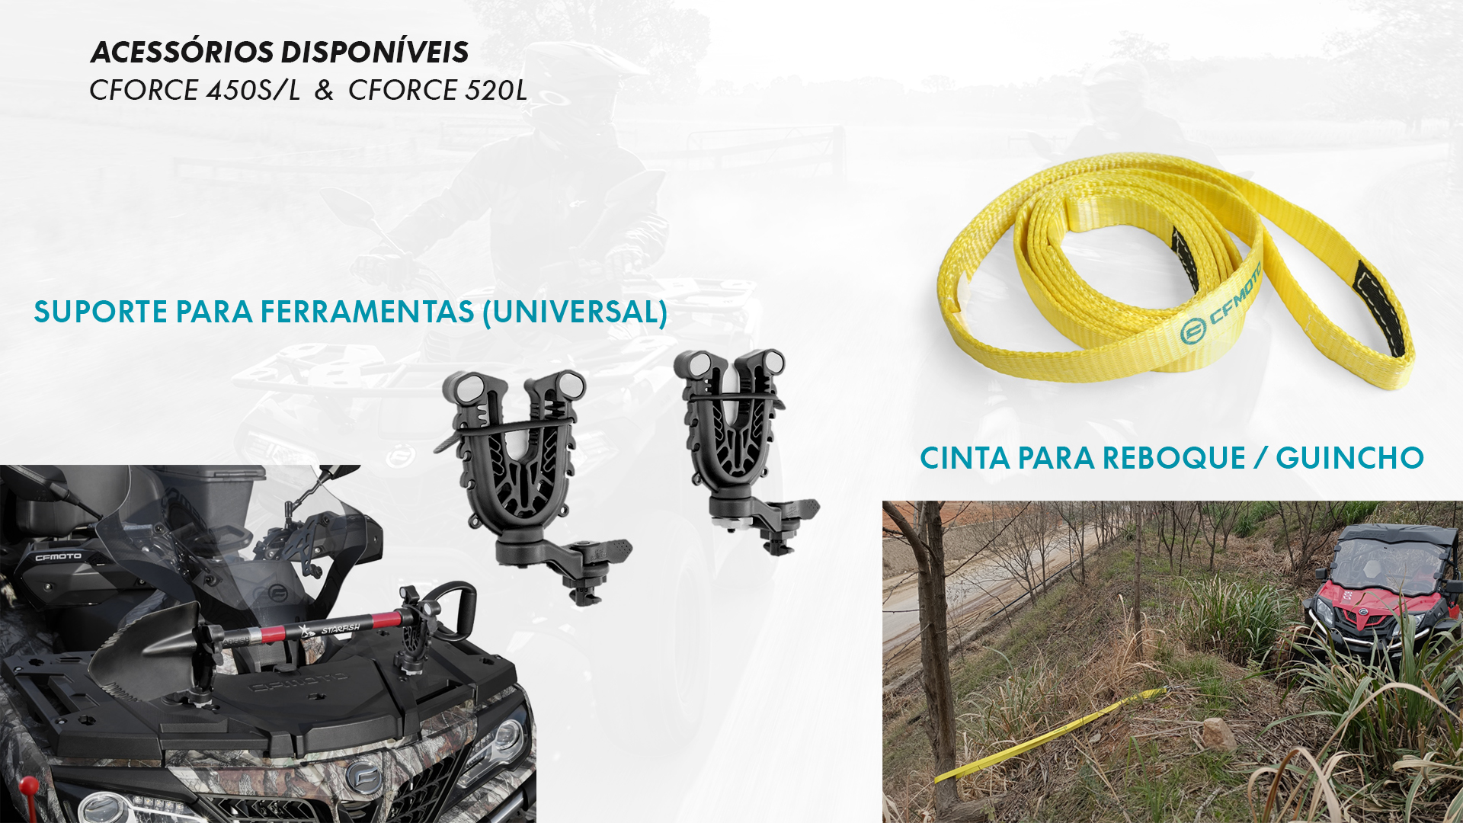
852114-00001
9DS#-808302-6000

